Slide 1

Expanding Moxey's Offerings
Increasing user base & revenue by Targeting Adjacent Industries in the MENA Region

Slide 2
Company Overview
Mission: Building banking and payment infrastructure for the mobility sector in MENA.
Current Operations-
Active in MENA and KSA, focusing on freight operators, employees, and truck drivers.
Key Products:
Prepaid cards for truck drivers.
Web portal for digital wallet management.
Mobile app for balance checks and transaction history.

Slide 3
SWOT Analysis
Strengths
Strong relationships with banks and financial institutions.
Weaknesses
Limited brand recognition outside the mobility sector.
Dependence on a niche market segment.
Opportunities
Expanding digital finance trends in adjacent industries.
Potential for strategic alliances with larger players in logistics.
Threats
Established technology platform tailored for mobility needs.
Competition from both fintech startups and traditional banks entering the market.
Economic fluctuations affecting logistics demand.

Slide 4
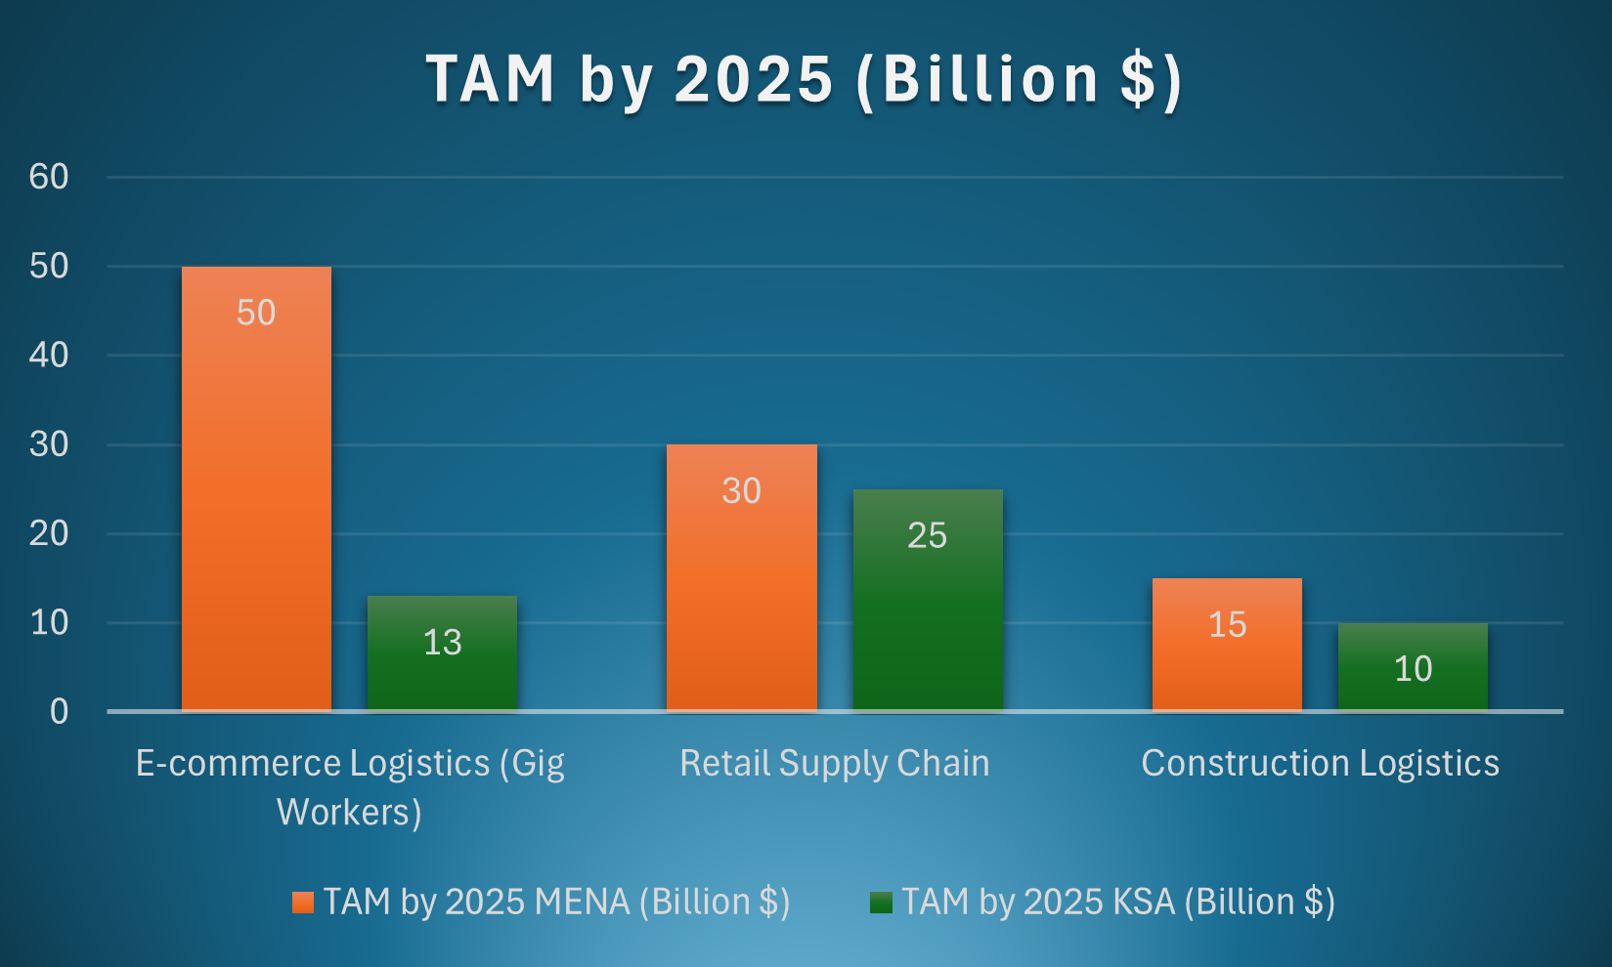
Target Adjacent Industries
1. E-commerce Logistics (Gig / Last mile Delivery Workers):
Rapid growth in online shopping due to changing consumer behaviours.
Increased demand for efficient last-mile delivery solutions as consumers expect faster delivery times.
2. Retail Supply Chain
Increasing number of retail outlets and e-commerce stores requiring efficient logistics solutions.
Demand for real-time inventory management and streamlined supply chain processes.
3. Construction Logistics
Major investments in infrastructure development across the region, particularly in KSA as part of Vision 2030.
Increasing complexity of construction projects requiring efficient logistics management.

Slide 5

User Persona

Slide 6

Last-Mile Delivery Worker
Name: Ahmed Al-Sayed
Age: 28
Occupation: Last-mile delivery driver for an e-commerce platform
Location: Riyadh, KSA
Income Level: $1,500/month
Education: High school diploma
Technology Usage: Smartphone user, familiar with mobile apps
Pain Points:
1. Limited access to traditional banking services.
2. Delayed payments from employers affect cash flow.
3. Difficulty managing expenses without a proper financial tool.
Goals:
- To receive payments instantly after deliveries.
- To manage finances better using a digital wallet.
- To access loans for personal emergencies.

Slide 7

Retail Supplier
Name: Fatima Al-Hassan
Age: 35
Occupation: Supplier for a local retail chain
Location: Jeedah, KSA
Income Level: $3,000/month
Education: Bachelor's degree in Business Administration
Technology Usage: Bachelor's degree in Business Administration
Pain Points:
1. Inefficient payment systems leading to cash flow issues.
2. Difficulty tracking payments and managing supplier relationships.
Goals:
- To streamline payment processes with suppliers.
- To access financial products that can help manage cash flow better.

Slide 8

Construction Transporter
Name: Omar Al-Mansoori
Age: 40
Occupation: Transport manager for a construction company
Location: Abu Dhabi, UAE
Income Level: $4,500/month
Education: Technical diploma in Logistics Management
Technology Usage: Technical diploma in Logistics Management
Pain Points:
Managing multiple payments and invoices can be cumbersome.
Lack of financial products tailored for the construction sector.
Goals:
To simplify payment processes for drivers and subcontractors.
To ensure timely payments to avoid project delays.

Slide 9



Pain Points
Limited Access to financial Services:
Many gig workers lack access to traditional banking products.
Cash Flow Issues:
Irregular income can lead to financial instability.
Payment Delays:
Delays in receiving payments from employers can disrupt personal finances.
Lack of Credit History:
Many gig workers do not have established credit histories, making it difficult to
access credit products.
4

Slide 10

Proposed Financial Products

Slide 11
Prepaid Card with Credit Assessment
Prepaid cards issued based on an assessment of user’s creditworthiness, which may include evaluating their earnings and transaction history, also their experience with the employer.
Key Features:
Real-time payment processing.
Notifications for successful transactions.
Integration with the prepaid card system for seamless fund access.
User Journey Stages

Slide 12
Instant Payment Solutions
A feature allowing users to receive payments instantly after completing deliveries or tasks through the Moxey mobile app.
Key Features:
1. Secure digital payments for receiving wages.
2. Usage across POS systems, ATMs, and online transactions.
3. Ability to set spending limits and track expenses via a mobile app.
User Journey Stages

Slide 13
Microloans for Gig Workers
Small loans offered to gig workers to help them manage expenses during lean periods or unexpected financial needs.
Key Features:
Quick loan approval process based on earnings history.
Flexible repayment options tailored user’s income cycles.
Educational resources on responsible borrowing.
User Journey Stages

Slide 14
Microloans for Gig Workers
Small loans offered to gig workers to help them manage expenses during lean periods or unexpected financial needs.
Key Features:
Quick loan approval process based on earnings history.
Flexible repayment options tailored user’s income cycles.
Educational resources on responsible borrowing.
User Journey Stages

Slide 15

Metrics Calculations

Slide 16
Prepaid Card with Credit Assessment
Card Issuance Rate
Number of prepaid cards issued to users: Measures adoption and market penetration.
2. Transaction Volume
Total value of transactions made using prepaid cards: Indicates user engagement and financial activity.
3. Transaction Frequency
Average number of transactions per user per month: Assesses how frequently users rely on the card for payments.
4. User Retention Rate
Percentage of users continuing to use the prepaid card over time: Evaluates customer satisfaction and loyalty.

Slide 17
Instant Payment Solutions
Loan Approval Rate
Percentage of loan applications approved versus total applications received. Measures accessibility and efficiency of loan processing.
2. Average Loan Amount
Average value of loans issued to gig workers: Assesses demand for microloans and financial needs of users.
3. Repayment Rate
Percentage of loans repaid on time versus total loans issued: Evaluates financial health of borrowers and effectiveness of lending criteria.
4. Default Rate
Percentage of loans that are not repaid within the agreed timeframe: Helps assess risk management practices in lending.

Slide 18
Go- To- Market Strategy
1. Partnership Development
Collaborate with e-commerce platforms (e.g., noon.com) and local delivery services.
Partner with logistics companies employing gig workers.
2. Targeted Marketing Campaigns
Focus on financial inclusion benefits through social media outreach targeting gig workers.
Use influencer marketing within the gig economy space.
3. User Education Programs
Conduct workshops/webinars on financial literacy tailored to gig workers’ needs.
4. Feedback Loop Implementation
Focus on financial inclusion benefits through social media outreach targeting gig workers.

Slide 19
Revenue Streams
Cost Analysis
Transaction fees from prepaid card usage.
Interest from microloans issued to gig workers.
Subscription fees for premium features on the web portal or mobile app.
Initial Setup Costs
Technology infrastructure (servers, software development): $200,000
Partnership onboarding (legal fees, integration): $50,000
Marketing campaigns (digital advertising, influencer partnerships): $100,000
Initial Setup Costs
Customer support team (hiring/training): $75,000 annually
Maintenance of technology infrastructure: $30,000 annually
Marketing and user education programs: $50,000 annually

